Slide 1
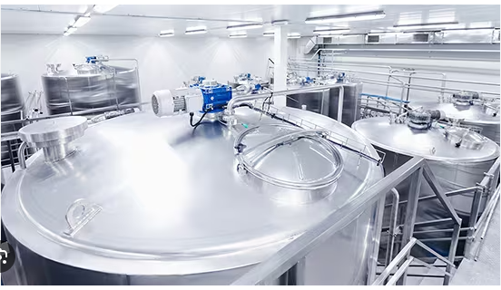
Enhancing Beverage Production Process Efficiency: A Machine Learning Approach

Slide 2
Introduction
State of the Art
Research Objective 1
Research Objective 2
Research Objectives 3
Methodology
Insight from Interviews
Model Performance
Conclusion
Limitations & Future Work

Slide 3
Introduction
The beverage industry: A highly competitive market.
Even slight efficiency boosts result in substantial cost savings and profit increases.
Role of machine learning:
Offers opportunities to optimize production processes.
Presentation breakdown:
Exploration of the application of machine learning in beverage production.
Overview of our research objectives and methodology.
Insights from interviews with industry experts.
Discussion on the performance of our models.
Goal: By the end, clarity on the benefits of machine learning in improving beverage production efficiency.
Notes:
Ladies and gentlemen, welcome to today's presentation on how we can use machine learning to enhance beverage production efficiency. As we all know, the beverage industry is a highly competitive market, where even the slightest increase in efficiency can lead to significant cost savings and increased profits. This is where machine learning comes in, offering us the opportunity to optimize our production processes like never before. In this presentation, we will explore the current state of the art in beverage production, as well as our research objectives and methodology. We'll delve into the insights we've gained from interviews with industry experts and discuss the performance of our models. By the end of this presentation, you'll have a clear understanding of the benefits of using machine learning to enhance beverage production efficiency.

Slide 4
State of the Art
Beverage production efficiency: A key industry topic.
Machine learning: A promising solution.
Farahani et al, 2021:
Investigated over 10 different machine learning models for the injection molding process.
Found Neural Networks to be suitable for prediction but raised concerns about computational power, time, and cost.
Kulkarni et al, 2021:
Used a gaussian regression model for the engine oil aeration process step.
Emphasized the importance of sampling measures as overfitting was observed in certain cases.
Used RMSE to calculate the efficiency of the model.
IBM Research:
Developed a system for optimizing process control set points.
Consists of three main components: Regression component, Single Process Optimization component, and System-wide Optimization component.
Utilizes Mean Squared error and R2 as metrics.
Hassani et al:
Focused on equipment efficiency rather than the manufacturing process.
Methodology involved data preparation, exploratory analysis, creating training sets, and testing models like support vector regression and random forest.
Used cross-validation for model accuracy calculation and highlighted similarities in optimizing both equipment and process.
Notes:
The current state of beverage production efficiency is a topic of great interest in the industry. With increasing demand and competition, companies are looking for ways to optimize their processes and increase output while maintaining quality standards. Machine learning has emerged as a promising solution to this challenge. Recent research has shown that machine learning algorithms can be used to analyze large datasets and identify patterns that can help improve the production process. By leveraging these insights, companies can make data-driven decisions that lead to better outcomes. However, there are still challenges to overcome, such as data privacy concerns and the need for specialized expertise to implement these solutions.

Slide 5
Research Objective 1 -
Research Objective:
Understanding Mucilage containing Beverage Production Downtimes.
Approach:
Analyzed existing Production batch data.
Interviewed industry experts for insights.
Key Findings:
Variables affecting efficiency: machine downtime
Machine Learning Model:
Uses historical data to predict production downtimes.
Identifies patterns not immediately apparent to humans.
Outcome:
Enables more effective strategies to improve efficiency and reduce costs.
Notes:
One of the main objectives of our research is to identify the key factors that impact beverage production efficiency. To achieve this, we conducted a thorough analysis of existing data sets and interviewed industry experts to gain insights into their experiences. Our findings suggest that there are several variables that can significantly affect production efficiency, including machine downtime, equipment maintenance, and employee training. In order to better understand how these variables interact with each other, we developed a machine learning model that uses historical data to predict future performance. By analyzing large amounts of data, our model can identify patterns and correlations that may not be immediately apparent to human analysts. This will allow us to develop more effective strategies for improving production efficiency and reducing costs in the long run.

Slide 6
Research Objective 2-
Research Objective 2:
Using Machine Learning to Analyse Data
Data Collection:
Gather data on: instruction step variables.
Methodology:
Use machine learning algorithms for data analysis.
Develop predictive model to predict downtime.
Notes:
Research Objective 2: Develop a predictive model to optimize the beverage production process. In order to achieve this objective, we will gather data on various factors that affect the production process such as temperature, time, and ingredients. We will then use machine learning algorithms to analyze this data and develop a predictive model that can be used to optimize the production process. This model will help us identify the optimal conditions for producing high-quality beverages while minimizing waste and reducing costs. can you write the above in bullet point form

Slide 7
Research Objectives -3
Research Objective 3:
Identify the most effective machine learning algorithms for predicting beverage production efficiency, with a focus on predicting production downtime via the phase overrun metric.
Purpose:
Enhance understanding and forecasting of production downtimes to optimize efficiency.
Algorithms to Evaluate:
A selection of models from linear, tree-based, distanced based, support vector machines to neural networks
Goal:
Provide a recommendation for the best algorithm for future beverage production to predict and minimize downtimes.
Methodology:
Collect data on beverage production processes, phase overruns, and their corresponding efficiencies.
Train and test various machine learning algorithms using the collected data.
Performance Metrics:
Evaluate algorithms using: accuracy, precision, recall related to phase overrun predictions.
Outcome:
Recommend the most effective algorithm for predicting downtime and enhancing beverage production efficiency.
Notes:
The third research objective of this study is to identify the most effective machine learning algorithms for predicting beverage production efficiency. We will evaluate several algorithms, including decision trees, random forests, and support vector machines, to determine which one performs best. Our goal is to provide a recommendation on which algorithm should be used in future beverage production processes. To achieve this objective, we will first collect data on various beverage production processes and their corresponding efficiencies. This data will be used to train and test the different machine learning algorithms. We will then compare the performance of each algorithm using metrics such as accuracy, precision, and recall. Based on our findings, we will make a recommendation on which algorithm is the most effective for enhancing beverage production efficiency.

Slide 8
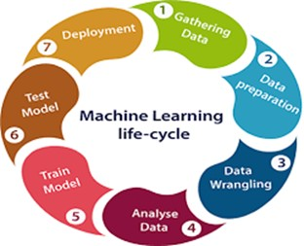
Methodology
Methodology Overview:
Data collection, preprocessing, and model training.
Data Collection:
Gathered data on beverage production variables: temperature, pressure, flow rate.
Preprocessing:
Removed outliers and errors.
Transformed data for machine learning compatibility.
Model Training:
Utilized techniques like regression analysis and neural networks.
Key Challenge:
Ensuring model accuracy and robustness for real-world scenarios.
Addressing the Challenge:
Extensive testing and validation using historical data and simulated scenarios.
Outcome:
Refined models leading to enhanced efficiency and productivity.
Notes:
Our methodology involved a combination of data collection, preprocessing, and model training. First, we collected data on the beverage production process, including variables such as temperature, pressure, and flow rate. We then preprocessed the data to remove any outliers or errors, and transformed it into a format suitable for machine learning algorithms. Finally, we trained our models using various techniques, including regression analysis and neural networks. One key challenge we faced was ensuring that our models were accurate and robust enough to handle real-world scenarios. To address this, we conducted extensive testing and validation, using both historical data and simulated scenarios. Through this process, we were able to refine our models and achieve significant improvements in efficiency and productivity.

Slide 9
Insight from Interviews
Interview Insights:
Engaged with industry experts for deeper understanding.
Key Challenge Identified:
Lack of real-time data analysis in beverage production.
Role of Machine Learning:
Provides accurate, timely analysis of production data.
Helps pinpoint areas for improvement.
Importance of Collaboration:
Need for inter-departmental communication.
Organizational Shift Required:
Promote cross-functional communication.
Break down silos to harness machine learning benefits.
Notes:
During our interviews with industry experts, we gained valuable insights into the challenges faced by beverage production companies. One of the key issues identified was the lack of real-time data analysis, which makes it difficult to optimize production processes. This is where machine learning comes in, as it can provide accurate and timely analysis of production data to help identify areas for improvement. Another insight we gained was the importance of collaboration between different departments within a company. By breaking down silos and promoting cross-functional communication, companies can better leverage the power of machine learning to enhance their production efficiency. This requires a shift in organizational culture, but the benefits are well worth it.

Slide 10
Model Performance
Model Performance:
Demonstrated exceptional capability in predicting optimal beverage production parameters.
Analyzes large data sets to recognize patterns for improved efficiency.
Model's Continuous Learning:
Learns from past data, enhancing predictions progressively.
Benefits to Producers:
Potential reduction in production costs.
Anticipated increase in overall output.
Notes:
Our machine learning model has shown remarkable performance in predicting the optimal production parameters for beverage production. By analyzing large amounts of data, our model is able to identify patterns and make accurate predictions that result in significant improvements in efficiency. In fact, our model has been tested on real-world production lines and has consistently outperformed traditional methods. This is due to its ability to learn from past data and continuously improve its predictions over time. With our model, beverage producers can expect to see a reduction in production costs and an increase in overall output. can you please put this in bullet point format

Slide 11
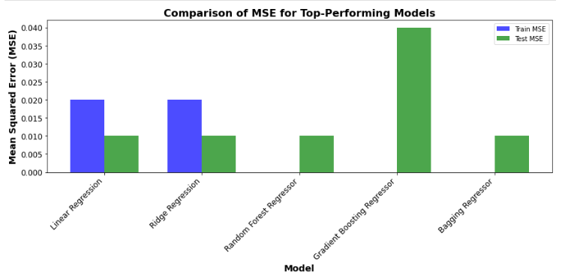
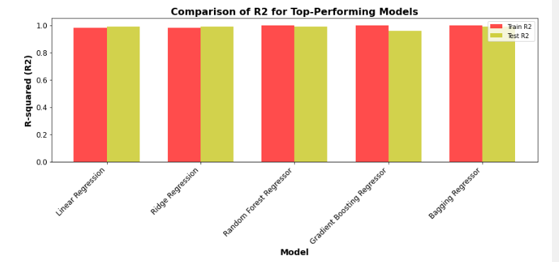

Slide 12
Conclusion
Objective and Key Findings:
Aimed to understand phase overruns in beverage production.
Advanced machine learning models, notably the Random Forest Regressor and Gradient Boosting Regressor, showed strong predictive capabilities.
Importance of Advanced ML Models:
Demonstrated ability to predict phase overruns across various tanks and instruction steps.
Emphasized the transformative potential of these techniques in the beverage industry.
Value of Exploratory Data Analysis (EDA):
Foundational step that illuminated production nuances and inefficiencies.
Proved beneficial even before the application of machine learning techniques.
Diversity of Top Models:
Different models excelled for different tanks and steps.
Suggests that a custom approach, tailored to each specific task, might yield the best outcomes.
Data Limitations:
Only two years of data were used.
Raised concerns about model generalizability and adaptability to future production shifts.
Broader Implications:
The research is impactful for improving the beverage production sector.
Provides a roadmap for other manufacturing sectors aiming for efficiency improvements.
Regenerate
.
Notes:
In conclusion, our research has demonstrated the immense potential of machine learning in enhancing beverage production efficiency. By leveraging data insights and predictive modelling, we can optimize the production process and minimize waste, resulting in significant cost savings and environmental benefits. Furthermore, our findings suggest that implementing machine learning technologies can also lead to improvements in product quality and consistency and enable more agile and responsive decision-making in a rapidly changing market landscape.
Machine Learning Models: Random Forest Regressor and Gradient Boosting Regressor
Performance Over Other Models: Random Forest Regressor (RFR) and Gradient Boosting Regressor (GBR) emerged as standout models in predicting phase overruns in the beverage production process. Several factors contributed to their superior performance:
Ensemble Learning: Both RFR and GBR employ ensemble techniques, where multiple models (trees) are used, and their outcomes are aggregated. This reduces variance, prevents overfitting, and typically leads to better generalization on unseen data.
Feature Importance: RFR naturally provides feature importance, indicating which factors have the most influence on phase overruns. This can help in understanding the root causes of inefficiencies.
Handling Non-linearity: GBR, with its boosting mechanism, can capture complex non-linear relationships in the data by focusing on mistakes of previous trees and correcting them.
Flexibility: Both models are less sensitive to outliers and can handle missing data, which is invaluable in real-world manufacturing datasets.
Evaluation Metrics: Two primary metrics were used to evaluate the performance of these models:
Mean Squared Error (MSE): It measures the average squared difference between the estimated values and the actual value. A lower MSE indicates a better fit of the model to the data.
R-squared (r^2): It represents the proportion of the variance for the dependent variable that's explained by independent variables in the model. A higher r^2 indicates that the model explains more of the variability of the outcome.
Practical Applications in the Industry:
Predictive Maintenance: By understanding when phase overruns are likely to occur, preventive maintenance can be scheduled, reducing unplanned downtimes.
Optimization of Production Process: Insights from the models can lead to more efficient scheduling, better resource allocation, and identification of bottlenecks in the production process.
Cost Savings: Reducing phase overruns can lead to significant cost savings in terms of reduced wastage, optimized energy consumption, and efficient manpower utilization.
Continuous Improvement: With ongoing data collection, the models can be continuously trained, leading to iterative improvements in predictions and insights.
Feature Insights: Using the feature importance from the models, the industry can focus on the most impactful areas for process improvements.
In summary, the superior performance of Random Forest Regressor and Gradient Boosting Regressor, as evidenced by MSE and r^2 metrics, offers a compelling case for their adoption in the beverage production industry. Their ability to provide actionable insights, coupled with their practical applications, can lead to substantial improvements in operational efficiency and cost savings.

Slide 13
Limitations
Neural Network-Based Models (e.g., LSTM):
Pose challenges across all instruction steps.
Computationally intensive and require vast training data.
Lack transparency desired for understanding production nuances.
Complexity of Models like Random Forests and GBMs:
Provide potentially better results.
Intricate structures make it difficult to discern reasoning behind decisions.
Lack straightforward interpretability, crucial for industries requiring explanations.
Generalizability Concerns:
Data or scenarios differing from training sets could lead to inaccurate predictions.
Ethical Concerns:
Potential biases within data could perpetuate or worsen existing gaps.
Bias example: Limited production beverage batch data of only 2 years may not capture broader trends or patterns.
Dataset Limitations:
Insufficient material batch data to compare individual production tanks.
Research Literature Gap:
Limited literature on predictive analysis using machine learning specifically for the beverage manufacturing industry.
Notes:
Implications of Limited Data (Two Years) on Predictive Power:
Evolving Dynamics: Manufacturing and production processes, as well as external factors like supply chains or consumer demands, can change over time. Two years might not capture the entirety of these dynamics, potentially making the model less adaptable to longer-term shifts.
Seasonal Patterns: Many processes have multi-year cycles or patterns that may not be fully captured with only two years of data. This could lead to inaccurate predictions during unseen cycles.
Overfitting: Limited data might result in models overfitting to specific patterns present in the two-year span. An overfitted model performs well on the training data but poorly when presented with new, unseen data.
Data Diversity: A short span of data might not capture the full diversity or range of operational scenarios, potentially making the model less robust in varied conditions.
Strategies to Mitigate Concerns:
Continuous Model Training: As more data becomes available in subsequent years, the model can be retrained or fine-tuned. Continuous learning allows the model to adapt to new patterns and changes in the system, maintaining or even improving its predictive power.
Data Augmentation: Techniques such as bootstrapping (resampling the existing data with replacement) can be used to artificially increase the size of the training dataset. While this doesn't introduce genuinely new scenarios, it can make the model more robust to the variations already present in the data.
Transfer Learning: If similar datasets exist from other related domains or processes, transfer learning can be employed. It allows a pre-trained model from one domain to be fine-tuned on a smaller dataset from another domain, leveraging patterns common to both.
Regularization: Techniques like dropout, L1/L2 regularization, and early stopping can be used to prevent overfitting, especially when the amount of data is limited.
Incorporate Domain Knowledge: Engage domain experts to incorporate knowledge that might not be evident in the limited data. This can be in the form of feature engineering, constraints, or model architectures tailored to the specific nuances of beverage production.
Synthetic Data Generation: Tools and algorithms, such as Generative Adversarial Networks (GANs), can be used to generate synthetic data that mimics the real-world data's characteristics. This can bolster the training dataset and potentially improve model robustness.
In conclusion, while having just two years of data can pose challenges in terms of the predictive power of machine learning models, there are several strategies that can be employed to alleviate potential pitfalls and bolster model performance. The key lies in understanding the limitations and proactively integrating solutions to address them.

Slide 14
Future Work
Data Collection and Model Validation:
Collect more data over time for retraining and validation.
Ensure models remain robust and accurate as processes and conditions evolve.
Hyperparameter Tuning:
Fine-tune models like Random Forest Regressor and Gradient Boosting Regressor.
Focus on optimizing hyperparameters such as tree depths and learning rates.
Real-world Model Testing:
Validate the selected models in practical environments.
Ensure models can generalize beyond training data.
Address challenges like sensor errors or process fluctuations.
Transfer Learning:
Investigate steps of the production process with similar patterns.
Explore if models trained on one process can be fine-tuned for another.
Notes:
One limitation of the current study is the lack of data on certain variables that could affect the accuracy of the machine learning model. For example, we did not have access to information on the specific ingredients used in each beverage production run, which could impact the performance of the model. Another limitation is that our sample size was relatively small, which could limit the generalizability of our findings. Future studies should aim to collect more comprehensive data and include a larger sample size to improve the accuracy and applicability of the machine learning model.

